Slide 1
Quick Introduction to React/Redux
Prepared by Burak Buruk

Slide 2
Traditional way “Multiple-page application”
Multiple-page applications work in a “traditional” way. Every change eg. display the data or submit data back to server requests rendering a new page from the server in the browser.

Slide 3
Single Page Applications
A single-page application is an app that works inside a browser and does not require page reloading during use. You are using this type of applications every day. These are, for instance: Gmail, Google Maps, Facebook or GitHub.
SPAs are all about serving an outstanding UX by trying to imitate a “natural” environment in the browser — no page reloads, no extra wait time. It is just one web page that you visit which then loads all other content using JavaScript — which they heavily depend on.

Slide 4
Server Rendered SPA
Most modern JavaScript frameworks are working on ways to handle server-side rendering of SPAs — meaning the user would get a fully populated page when the SPA is loaded for the first time, instead of, for example, seeing a loading indicator.
Server-side rendering can alleviate some of the burden browsers have to go through when rendering pages, and will also help with the problem of SEO and content discoverability.

Slide 5
Javascript Interpreted
JavaScript code needs a tool (JS engine) installed in your machine (node, browser) to get executed.
Errors only shown when they are executed.

Slide 6
Nodejs
Node.js® is a JavaScript runtime built on Chrome's V8 JavaScript engine. Node.js uses an event-driven, non-blocking I/O model that makes it lightweight and efficient. Node.js' package ecosystem, npm, is the largest ecosystem of open source libraries in the world.

Slide 7
Npm
npm is the package manager for JavaScript and the world’s largest software registry.
Comes with nodejs.
Nexus repo intranet
Configure it from .npmrc file under user

Slide 8
What about asynchronous code in JavaScript?
All asynchronous code in JavaScript is based on Web APIs that are provided by the browser.
all of them provide the possibility of executing a callback function.
We could distinguish two groups of such APIs:
  First, fires a callback after some work is done. It could be handling AJAX request
  Second, setTimeout(callback, time) and setInterval(callback, time) functions. (One of their main purpose is to provide us the means of breaking synchronous execution into asynchronous parts. “not earlier than, but after the specified time”)
    setTimeout – runs a callback once after specified amount of time
    setInterval – runs a callback at a specified time interval

Slide 9
“use strict”
Declared at the beginning of a script, it has global scope (all code in the script will execute in strict mode):
"use strict";
x = 3.14; // This will cause an error because x is not declared
x = 3.14; // This will not cause an error.
myFunction();
function myFunction() {
"use strict";
y = 3.14; // This will cause an error
}

Slide 10
Javascript History
1995: JavaScript is born as LiveScript
1997: ECMAScript standard is established
1999: ES3 comes out and IE5 is all the rage
2000–2005: XMLHttpRequest, a.k.a. AJAX, gains popularity in app such as Outlook Web Access (2000) and Oddpost (2002), Gmail (2004) and Google Maps (2005).
2009: ES5 comes out (this is what most of us use now) with forEach, Object.keys, Object.create (specially for Douglas Crockford), and standard JSON
2015: ES6/ECMAScript2015 comes out; it has mostly syntactic sugar, because people weren’t able to agree on anything more ground breaking.
2016: ES7/ECMAScript2016 Seventh edition of ECMAScript.
2017: ES8/ECMAScript2017 Eighth edition of ECMAScript.

Slide 11
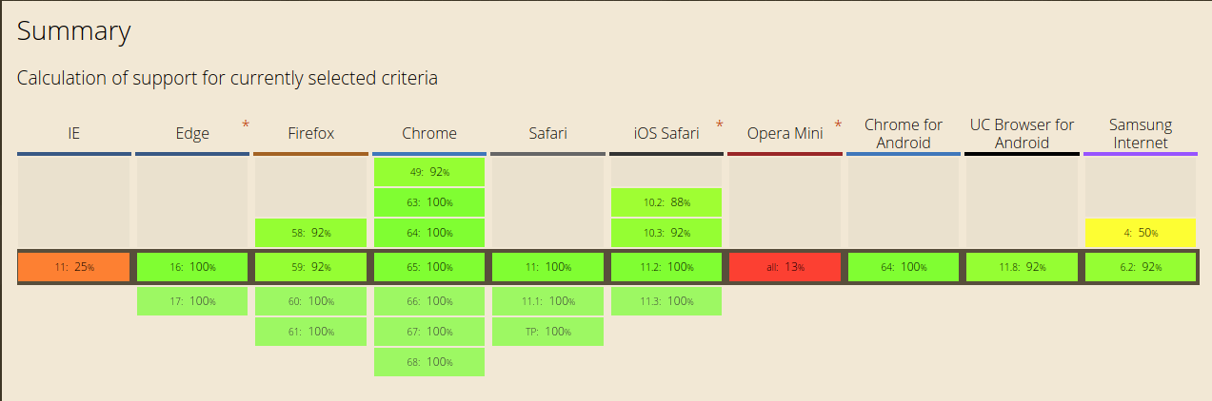
ES 6 Supported Browsers

Slide 12
ES 6
Default Parameters in ES6
Template Literals in ES6
Multi-line Strings in ES6
Destructuring Assignment in ES6
Enhanced Object Literals in ES6
Arrow Functions in ES6
Promises in ES6
Block-Scoped Constructs Let and Const
Classes in ES6
Modules in ES6

Slide 13
Promises in ES6
var p = new Promise((resolve, reject) => {
resolve(5);
});
p.then((val) => console.log(val)); // 5
p.catch((err) => console.log("error:", err.message));
// A Promise that throws, rather than explicitly reject
throw new Error("rejected!"); // same as rejection
var fetchJSON = function(url) {
return new Promise((resolve, reject) => {
$.getJSON(url)
.done((json) => resolve(json))
.fail((xhr, status, err) => reject(status + err.message));
});
}

Slide 14
Promise.all
The Promise.all(iterable) method returns a single Promise that resolves when all of the promises in the iterable argument have resolved or when the iterable argument contains no promises.
It rejects with the reason of the first promise that rejects.
Promise.all is rejected if any of the elements are rejected. For example, if you pass in four promises that resolve after a timeout and one promise that rejects immediately, then Promise.all will reject immediately.

Slide 15
Promise.all Example
var promise1 = Promise.resolve(3);
var promise2 = 42;
var promise3 = new Promise(function(resolve, reject) {
setTimeout(resolve, 100, 'foo');
});
Promise.all([promise1, promise2, promise3]).then(function(values) {
console.log(values);
});
// expected output: Array [3, 42, "foo"]

Slide 16
ES 7
Object Rest / Spread Properties
Observables
Async functions

Slide 17
Async Functions
An async function can contain an await expression that pauses the execution of the async function and waits for the passed Promise's resolution, and then resumes the async function's execution and returns the resolved value.
Remember, the await keyword is only valid inside async functions. If you use it outside of an async function's body, you will get a SyntaxError.

Slide 18
Async Functions Example
function resolveAfter2Seconds() {
return new Promise(resolve => {
setTimeout(() => {
resolve('resolved');
}, 2000);
});
}
async function asyncCall() {
console.log('calling');
var result = await resolveAfter2Seconds();
console.log(result);
// expected output: "resolved"
}
asyncCall();

Slide 19
Do not confuse await for Promise.all
function resolveAfter2Seconds(x) {
return new Promise(resolve => {
setTimeout(() => {
resolve(x);
}, 2000);
});
}
async function add1(x) {
const a = await resolveAfter2Seconds(20);
const b = await resolveAfter2Seconds(30);
return x + a + b;
}
add1(10).then(v => {
console.log(v); // prints 60 after 4 seconds.
});
async function add2(x) {
const p_a = resolveAfter2Seconds(20);
const p_b = resolveAfter2Seconds(30);
return x + await p_a + await p_b;
}
add2(10).then(v => {
console.log(v); // prints 60 after 2 seconds.
});

Slide 20
Async misuse!
(async () => {
const pizzaData = await getPizzaData() // async call
const drinkData = await getDrinkData() // async call
const chosenPizza = choosePizza() // sync call
const chosenDrink = chooseDrink() // sync call
await addPizzaToCart(chosenPizza) // async call
await addDrinkToCart(chosenDrink) // async call
orderItems() // async call
})()
Explanation
We have wrapped our code in an async IIFE. The following occurs in this exact order:
Get the list of pizzas.
Get the list of drinks.
Choose one pizza from the list.
Choose one drink from the list.
Add the chosen pizza to the cart.
Add the chosen drink to the cart.
Order the items in the cart.

Slide 21
Async Problem
Why are we waiting to get the list of pizzas before trying to get the list of drinks?
We should just try to get both the lists together.
However when we need to choose a pizza, we do need to have the list of pizzas beforehand. The same goes for the drinks.

Slide 22
Solution for the Scenario
Find statements which depend on the execution of other statements
Group-dependent statements in async functions
Execute these async functions concurrently

Slide 23
Let’s fix the examples
async function selectPizza() {
const pizzaData = await getPizzaData() // async call
const chosenPizza = choosePizza() // sync call
await addPizzaToCart(chosenPizza) // async call
}
async function selectDrink() {
const drinkData = await getDrinkData() // async call
const chosenDrink = chooseDrink() // sync call
await addDrinkToCart(chosenDrink) // async call
}
(async () => {
const pizzaPromise = selectPizza()
const drinkPromise = selectDrink()
await pizzaPromise
await drinkPromise
orderItems() // async call
})()
// Although I prefer it this way
(async () => {
Promise.all([selectPizza(), selectDrink()].then(orderItems) // async call
})()

Slide 24
New Project
What will we use?
Npm
Webpack
Babel (js loader, css loader, style loader)
ES6-ES7
Nodejs for server
Axios for http requests
Material UI
Reactjs
Redux

Slide 25
Everything starts with npm init command
It will create a package.json
{
"name": "javascript-test",
"version": "1.0.0",
"description": "It creates a javascript template",
"main": "index.js",
"scripts": {
"build": "npm run clean && webpack",
"start": "npm run build && node server.js",
"clean": "rimraf build",
"test": "echo \"Error: no test specified\" && exit 1"
},
"repository": {
"type": "git",
"url": "git+https://github.com/burakburuk/javascript-test.git"
},
"author": "",
"license": "ISC",
….
}

Slide 26
dependencies and devDependencies
"devDependencies": {
"babel-cli": "^6.26.0",
"babel-core": "^6.26.0",
"babel-loader": "^7.1.2",
"babel-plugin-transform-class-properties": "^6.24.1",
"babel-preset-es2015": "^6.24.1",
"babel-preset-es2017": "^6.24.1",
"babel-preset-react": "^6.24.1",
"babel-preset-stage-2": "^6.24.1",
"css-loader": "^0.28.11",
"open": "0.0.5",
"raw-loader": "^0.5.1",
"react-core": "0.0.0",
"rimraf": "^2.6.2",
"webpack": "^3.10.0",
"webpack-dev-middleware": "^2.0.4",
"webpack-hot-middleware": "^2.21.0"
}
"dependencies": {
"axios": "^0.18.0",
"babel-polyfill": "^6.26.0",
"express": "4.16.2",
"material-ui": "^0.20.0",
"react": "^16.2.0",
"react-dom": "^16.2.0"
}

Slide 27
Webpack
Webpack is a module bundler.
Webpack can take care of bundling alongside a separate task runner.
React, and Hot Module Replacement (HMR) helped to popularize webpack and led to its usage in other environments, such as Ruby on Rails.
The smallest project you can bundle with webpack consists of input and output. The bundling process begins from user-defined entries.
Entries themselves are modules and can point to other modules through imports.
When you bundle a project using webpack, it traverses through imports, constructing a dependency graph of the project and then generating the output based on the configuration.

Slide 28
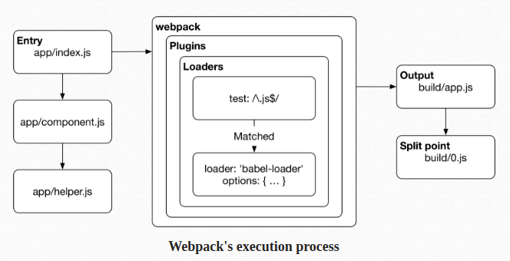
Webpack's Execution Process

Slide 29
Webpack.config.js
module.exports = {
devtool: 'inline-source-map',
resolve: {
alias: {}
},
entry: [
'babel-polyfill',
'webpack-hot-middleware/client',
path.resolve(__dirname, 'src/index.js')
],
output: {
path: path.resolve(__dirname, 'build'),
publicPath: '/',
filename: 'bundle.js'
},
module: {
loaders: [
{
test: /\.js?$/,
loader: 'babel-loader',
exclude: /node_modules/,
query: {
presets: ['es2015', 'react', 'stage-2']
}
},
{
test: /\.html$/,
loader: 'raw-loader'
},
{
test: /\.css$/,
loader: ['style-loader', 'css-loader']
}
]
},
plugins: [
new webpack.HotModuleReplacementPlugin(),
new webpack.NoEmitOnErrorsPlugin()
]
};

Slide 30
Webpack.config.js
devtool: 'inline-source-map' //for debug configuration
entry: [
'babel-polyfill',
'webpack-hot-middleware/client',
path.resolve(__dirname, 'src/index.js')
],
output: {
path: path.resolve(__dirname, 'build'),
publicPath: '/',
filename: 'bundle.js'
}

Slide 31
Webpack.config.js
//module loaders
loaders: [
{
test: /\.js?$/,
loader: 'babel-loader',
exclude: /node_modules/,
query: {
presets: ['es2015', 'react', 'stage-2']
}
},
{
test: /\.html$/,
loader: 'raw-loader'
},
{
test: /\.css$/,
loader: ['style-loader', 'css-loader']
}
]

Slide 32
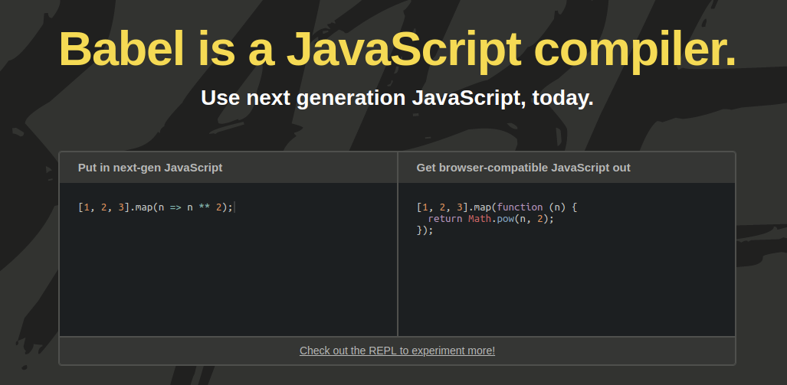
Babel

Slide 33
.babelrc
Ignores files or folders you specified.
{
"plugins": ["transform-react-jsx"],
"ignore": [
"foo.js",
"bar/**/*.js"
]
}

Slide 34
.babelrc - Use via package.json
{
"name": "my-package",
"version": "1.0.0",
"babel": {
// my babel config here
}
}

Slide 35
CSS into html
//mystyle.css
body {
background-color: lightblue;
}
h1 {
color: navy;
margin-left: 20px;
}
<head>
<link rel="stylesheet" type="text/css" href="mystyle.css">
</head>

Slide 36
CSS with webpack
Style-loader
Css-loader
loaders: [
{
test: /\.css$/,
loader: ['style-loader', 'css-loader']
}
]
import '../assets/main.css';

Slide 37
Axios Integration
axios.post('/user', {
firstName: 'Fred',
lastName: 'Flintstone'
})
.then(function (response) {
console.log(response);
})
.catch(function (error) {
console.log(error);
});
// Make a request for a user with a given ID
axios.get('/user?ID=12345')
.then(function (response) {
console.log(response);
})
.catch(function (error) {
console.log(error);
});

Slide 38
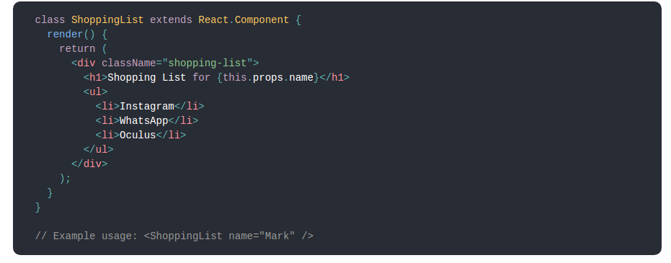
What is Reactjs
React is a declarative, efficient, and flexible JavaScript library for building user interfaces.
ReactJS basically is an open-source JavaScript library which is used for building user interfaces specifically for single page applications.
React also allows us to create reusable UI components.

Slide 39
Why React Js?
Simplicity
Easy to learn (Ironic)
Data Binding
Performance
Testability

Slide 40
JSX
In React, instead of using regular JavaScript for templating, it uses JSX.
class App1 {
render(){
return <Greeting firstName="Ben" lastName="Hector" />;
}
}
const App = () => {
return (
<div>
<Button kind="primary" onClick={() => console.log("clicked!")}>
Hello World!
</Button>
</div>
);
};

Slide 41
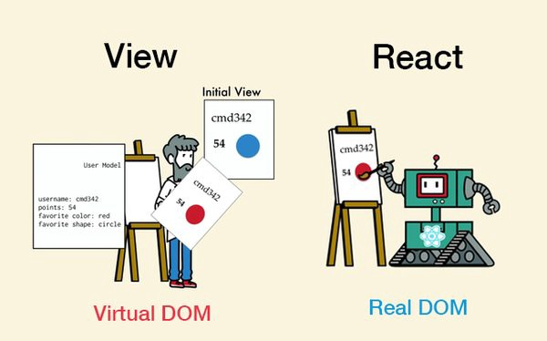
Virtual DOM
React creates an in-memory data structure cache which computes the changes made and then updates the browser.
React library only render components which actually change.

Slide 42
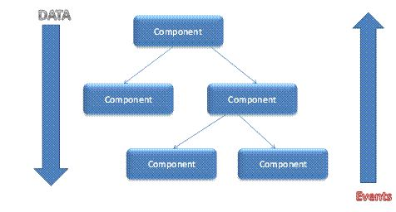
Single-Way data flow
Component cannot directly modify any properties but can pass a call back function with help of which we can do modifications.

Slide 43
Some methods and properties
Instance Properties
props
State
Each component also provides some other APIs:
setState()
ForceUpdate()
Class Properties
DefaultProps
displayName

Slide 44
props
this.props contains the props that were defined by the caller of this component.
In particular, this.props.children is a special prop, typically defined by the child tags in the JSX expression rather than in the tag itself.

Slide 45
DefaultProps
If props.color is not provided, it will be set by default to 'blue'
If props.color is set to null, it will remain null
class CustomButton extends React.Component {
// ...
}
CustomButton.defaultProps = {
color: 'blue'
};

Slide 46
state
The state contains data specific to this component that may change over time. The state is user-defined, and it should be a plain JavaScript object.
If you don’t use it in render(), it shouldn’t be in the state. For example, you can put timer IDs directly on the instance.
Never mutate this.state directly, as calling setState() afterwards may replace the mutation you made. Treat this.state as if it were immutable.

Slide 47
setState()
setState() enqueues changes to the component state and tells React that this component and its children need to be re-rendered with the updated state.
Think of setState() as a request rather than an immediate command to update the component.
React does not guarantee that the state changes are applied immediately.
setState() will always lead to a re-render unless shouldComponentUpdate() returns false.
this.setState((prevState, props) => {
return {counter: prevState.counter + props.step};
});

Slide 48
React life cycle
Methods prefixed with will are called right before something happens.
Methods prefixed with did are called right after something happens.

Slide 49
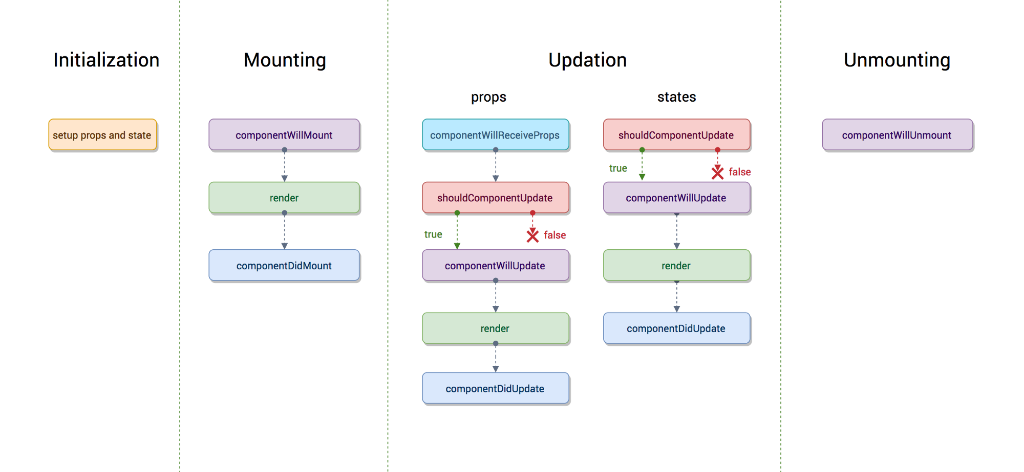
React life cycle

Slide 50
Mounting
These methods are called when an instance of a component is being created and inserted into the DOM:
constructor()
componentWillMount()
render()
componentDidMount()

Slide 51
React Component Constructor
The constructor for a React component is called before it is mounted.
The constructor is the right place to initialize state.
Just assign an object to this.state; don’t try to call setState() from the constructor.
The constructor is also often used to bind event handlers to the class instance.
constructor(props) {
super(props);
this.state = {
color: props.initialColor
};
}

Slide 52
componentDidMount()
componentDidMount() is invoked immediately after a component is mounted.
This is a good place to instantiate the network request from a remote endpoint.
Calling setState() in this method will trigger an extra rendering, but it will happen before the browser updates the screen.

Slide 53
Updating
An update can be caused by changes to props or state. These methods are called when a component is being re-rendered:
componentWillReceiveProps()
shouldComponentUpdate()
componentWillUpdate()
render()
componentDidUpdate()

Slide 54
shouldComponentUpdate()
Use shouldComponentUpdate() to let React know if a component’s output is not affected by the current change in state or props.
shouldComponentUpdate() is invoked before rendering when new props or state are being received.
Defaults to true.
This method is not called for the initial render or when forceUpdate() is used.

Slide 55
Unmounting
This method is called when a component is being removed from the DOM:
componentWillUnmount()

Slide 56
Error Handling
This method is called when there is an error during rendering, in a lifecycle method, or in the constructor of any child component.
componentDidCatch()

Slide 57
componentDidCatch()
Error boundaries are React components that catch JavaScript errors anywhere in their child component tree, log those errors, and display a fallback UI instead of the component tree that crashed.
Error boundaries catch errors during rendering, in lifecycle methods, and in constructors of the whole tree below them.

Slide 58

Material UI Components

Slide 59
First React App
https://github.com/burakburuk/javascript-boilerplate

Slide 60
Differences between MVC and Flux
MVC
Model, View, Controller
Communication between M ↔ V (2 way)
Flux
Dispatcher, Store, View
Single way communication
Only 1 action at 1 time.

Slide 61
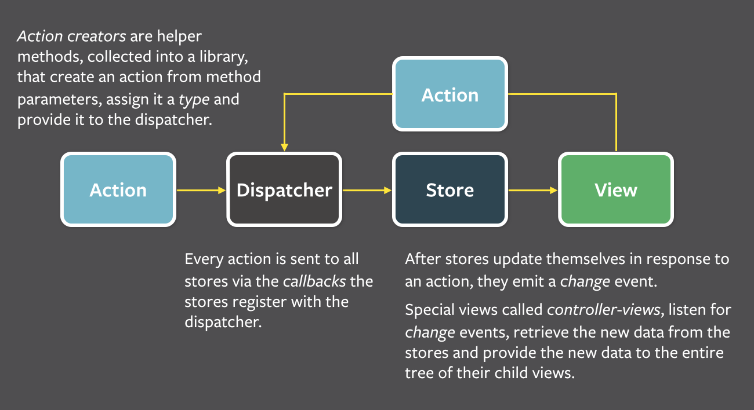
Flux

Slide 62
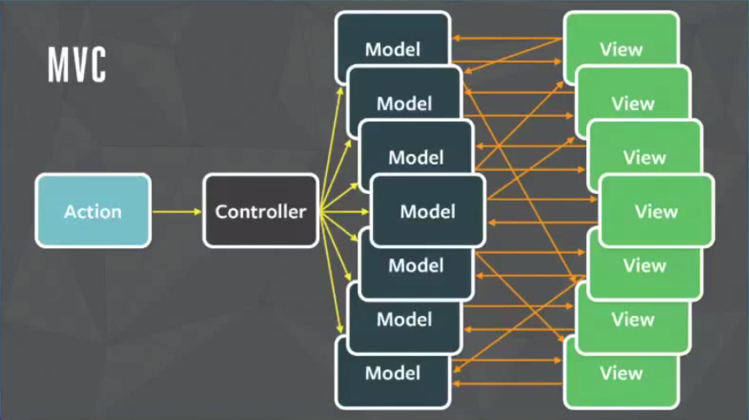
MVC

Slide 63
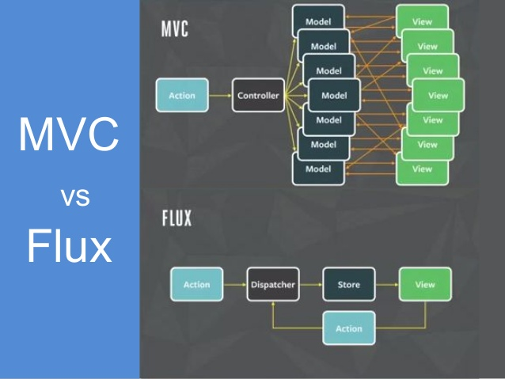
MVC vs Flux

Slide 64
Advantages of Flux
Single source of truth
Easier to find bugs
Easier to implement Unit tests

Slide 65
Flux Example
var flightDispatcher = new Dispatcher();
//Keeps track of which country is selected
var CountryStore = {country: null};
//Keeps track of which city is selected
var CityStore = {city:null};
//Keeps track of the base flight price of the selected city
var FlightPriceStore = {price:null};
flightDispatcher.dispatch({
actionType: 'city-update',
selectedCity:'paris'
});
flightDispatcher.register(function (payload) {
if (payload.actionType === 'city-update'){
CityStore.city = payload.selectedCity;
}
})

Slide 66
Redux
Redux has no relation to React.
You can write Redux apps with React, Angular, Ember, jQuery, or vanilla JavaScript.
Redux keeps the state of your app in a single store.
you can extract parts of that state and plug it into your components as props.
No need passing props down multiple levels.
Similar to Flux
It uses reducers instead of dispatchers.
It uses pure functions instead of event emitters.
Redux creates new state.

Slide 67
Redux 3 Principles
Single source of truth
State is read-only
Changes are made with pure functions

Slide 68
Single source of truth
The state of your whole application is stored in an object tree within a single store.
A single state tree also makes it easier to debug or inspect an application.
It also enables you to persist your app's state in development, for a faster development cycle.

Slide 69
Ex: Single source of truth
console.log(store.getState())
{
visibilityFilter: 'SHOW_ALL',
todos: [
{
text: 'Consider using Redux',
completed: true,
},
{
text: 'Keep all state in a single tree',
completed: false
}
]
}

Slide 70
State is read-only
The only way to change the state is to emit an action, an object describing what happened.
This ensures that neither the views nor the network callbacks will ever write directly to the state. Instead, they express an intent to transform the state.
All changes are centralized and happen one by one in a strict order.
As actions are just plain objects, they can be logged, serialized, stored, and later replayed for debugging or testing purposes.

Slide 71
State is read-only
store.dispatch({
type: 'COMPLETE_TODO',
index: 1
})
store.dispatch({
type: 'SET_VISIBILITY_FILTER',
filter: 'SHOW_COMPLETED'
})

Slide 72
Changes are made with pure functions
To specify how the state tree is transformed by actions, you write pure reducers.
Reducers are just pure functions that take the previous state and an action, and return the next state.
Split reducers off into smaller reducers that manage specific parts of the state tree.

Slide 73
Changes are made with pure functions
function todos(state = [], action) {
switch (action.type) {
case 'ADD_TODO':
return [
...state,
{
text: action.text,
completed: false
}
]
case 'COMPLETE_TODO':
return state.map((todo, index) => {
if (index === action.index) {
return Object.assign({}, todo, {
completed: true
})
}
return todo
})
default:
return state
}
}
function visibilityFilter(state = 'SHOW_ALL', action) {
switch (action.type) {
case 'SET_VISIBILITY_FILTER':
return action.filter
default:
return state
}
}
import { combineReducers, createStore } from 'redux'
const reducer = combineReducers({ visibilityFilter, todos })
const store = createStore(reducer)

Slide 74
Libs: Redux and react-redux
See, redux gives you a store, and lets you keep state in it, and get state out, and respond when the state changes.
It’s actually react-redux that lets you connect pieces of the state to React components. That’s right: redux knows nothing about React at all.

Slide 75
Rewrite with redux
<span id="counter-span">{this.props.count}</span>
Wiring Up The Counter
Notice that {this.state.count} changed to {this.props.count}. This won’t work yet, of course, because the Counter is not receiving a count prop. We’re gonna use Redux to inject that.
To get the count out of Redux, we first need to import the connect function at the top
  import { connect } from 'react-redux';

Slide 76
Rewrite with redux - connect
Then we need to “connect” the Counter component to Redux at the bottom:
// Add this function:
function mapStateToProps(state) {
return {
count: state.count
};
}
// Then replace this:
// export default Counter;
// With this:
export default connect(mapStateToProps)(Counter);

Slide 77
Rewrite with redux - connect
What’s connect?
You might notice the call looks little… weird. Why connect(mapStateToProps)(Counter) and not connect(mapStateToProps, Counter) or connect(Counter, mapStateToProps)? What’s that doing?
It’s written this way because connect is a higher-order function, which is a fancy way of saying it returns a function when you call it. And then calling that function with a component returns a new (wrapped) component.
The object you return from mapStateToProps gets fed into your component as props.
The example above will pass state.count as the value of the count prop: the keys in the object become prop names, and their corresponding values become the props’ values. So you see, this function literally defines a mapping from state into props.

Slide 78
Rewrite with redux - store
Get Error
Could not find “store” in either the context or props of “Connect(Counter)”. Either wrap the root component in a , or explicitly pass "store" as a prop to "Connect(Counter)".
Since connect pulls data from the Redux store, and we haven’t set up a store or told the app how to find it, this error is pretty logical.

Slide 79
Provide a Store
Redux holds the global state for the entire app, and by wrapping the entire app with the Provider component from react-redux, every component in the app tree will be able to use connect to access the Redux store if it wants to.
App and all of its children can now access the Redux store, but only if they are explicitly wrapped by a call to connect.
import { Provider } from 'react-redux';
const App = () => (
<Provider>
<Counter/>
</Provider>
);

Slide 80
Create the Store
We’re still getting that error though – that’s because Provider needs a store to work with. It’ll take the store as a prop, but we need to create one first.
Redux comes with a handy function that creates stores, and it’s called createStore.
import { createStore } from 'redux';
const store = createStore();
const App = () => (
<Provider store={store}>
<Counter/>
</Provider>
);

Slide 81
Another error, but different this time
You might expect that by creating a store, it would give you a nice default value for the state inside that store.
Redux makes zero assumptions about the shape of your state. It’s up to you!
It could be an object, or a number, or a string, or whatever you need. So we have to provide a function that will return the state.
function reducer() {
// just gonna leave this blank for now
// which is the same as `return undefined;`
}
const store = createStore(reducer);

Slide 82
The Reducer Should Always Return Something
Error: Cannot read property ‘count’ of undefined
We’re trying to access state.count, but state is undefined.
Redux expected our reducer function to return a value for state, except that it (implicitly) returned undefined.
function reducer() {
return {
count: 42
};
}

Slide 83
The Story So Far
We wrote a mapStateToProps function that does what the name says: transforms the Redux state into an object containing props.
We connected the Redux store to our Counter component with the connect function from react-redux, using the mapStateToProps function to configure how the connection works.
We created a reducer function to tell Redux what our state should look like.
We used the ingeniously-named createStore function to create a store, and passed it the reducer.
We wrapped our whole app in the Provider component that comes with react-redux, and passed it our store as a prop.
The app works flawlessly, except the fact that the counter is stuck at 42.

Slide 84
Initial State
The very first time Redux calls this function, it will pass undefined as the state. That is your cue to return the initial state. For us, that’s probably an object with a count of 0.
function reducer(state, action) {
return {
count: 42
};
}
const initialState = {
count: 0
};
function reducer(state = initialState, action) {
return state;
}

Slide 85
Action
It is an object
{
type: "INCREMENT"
}

Slide 86
Respond to Actions
It’s common to use a switch statement with cases for each action you want to handle. Change your reducer to look like this:
function reducer(state = initialState, action) {
switch(action.type) {
case 'INCREMENT':
return {
count: state.count + 1
};
case 'DECREMENT':
return {
count: state.count - 1
};
default:
return state;
}
}

Slide 87
Never Change State
Do not mutate the state. State is immutable. You must never change it. That means you can’t do this:
You also can’t do things like state.foo = 7, or state.items.push(newItem), or delete state.something
function brokenReducer(state = initialState, action) {
switch(action.type) {
case 'INCREMENT':
state.count++;
return state;
case 'DECREMENT':
state.count--;
return state;
default:
// this is fine.
return state;
}
}

Slide 88
Dispatch as a prop
In addition to injecting the result of mapStateToProps as props, connect also injects the dispatch function as a prop. And with that bit of knowledge, we can finally get the counter working again.

Slide 89
Dispatch
import React from 'react';
import { connect } from 'react-redux';
class Counter extends React.Component {
increment = () => {
this.props.dispatch({ type: 'INCREMENT' });
}
decrement = () => {
this.props.dispatch({ type: 'DECREMENT' });
}
render() {
return (
<div>
<h2>Counter</h2>
<div>
<button onClick={this.decrement}>-</button>
<span>{this.props.count}</span>
<button onClick={this.increment}>+</button>
</div>
</div>
)
}
}

Slide 90
References
https://webapplog.com/es6/
https://derickbailey.com/2017/06/06/3-features-of-es7-and-beyond-that-you-should-be-using-now/
https://www.npmjs.com/package/axios
https://www.w3schools.com/
https://caniuse.com/#search=es6
https://nodejs.org/en/
https://developer.mozilla.org/en-US/docs/Web/JavaScript/Reference/Classes
https://scotch.io/tutorials/setup-a-react-environment-using-webpack-and-babel
https://github.com/mui-org/material-ui

Slide 91
References
https://reactjs.org/tutorial/tutorial.html
https://github.com/burakburuk/javascript-boilerplate
http://www.material-ui.com/#/
https://redux.js.org/basics/usage-with-react

